Slide 1

Noida Institute of Engineering and Technology, Greater Noida
Basics Of Sustainability
Unit: 1
Sustainable Technologies
AOE 0866
ANAMIKA SRIVASTAVA
Assistant Professor
CSE,CSE R & M.Tech Integ.
CSE 8TH SEM

Slide 2
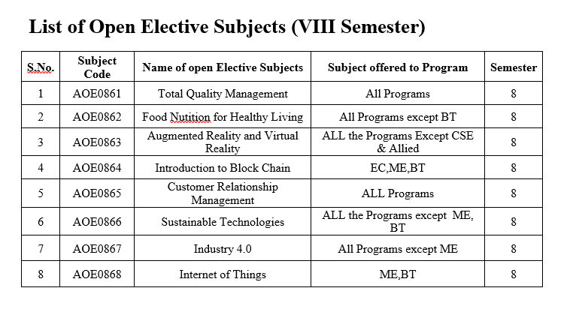
Evaluation Scheme

Slide 3
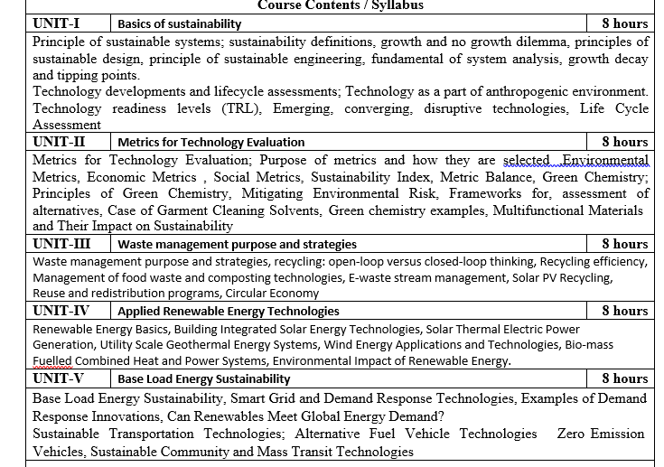
Syllabus

Slide 4
Branch wise Application
First, we will start with the internet which is very much important for our daily life and we cannot even imagine our life without the internet and it is the outcome of clever and creative algorithms. Numerous sites on the internet can operate and falsify this huge number of data only with the help of these algorithms.
The everyday electronic commerce activities are massively subject to our data, for example, credit or debit card numbers, passwords, OTPs, and many more. The centre technologies used incorporate public-key cryptocurrency and digital signatures which depend on mathematical algorithms.
Even an application that doesn't need algorithm content at the application level depends vigorously on the algorithm as the application relies upon hardware, GUI, networking, or object direction and all of these create a substantial use of algorithms.
There are some other vital use cases where the algorithm has been used such as if we watch any video on YouTube then next time we will get related-type advice as recommended videos for us.

Slide 5
Course Objective
Upon completion of this course, students will be able to do the following:
Analyze the asymptotic performance of algorithms.
Write rigorous correctness proofs for algorithms.
Demonstrate a familiarity with major algorithms and data structures.
Apply important algorithmic design paradigms and methods of analysis.
Synthesize efficient algorithms in common engineering design situations.

Slide 6
Course Outcome
At the end of the semester, the student will be able:
 | Description | Bloom’s Taxonomy
CO1 | To have knowledge of basic principles of algorithm design and Analysis, asymptotic notations and growth of functions for time and space complexity analysis and applying the same in different sorting algorithms | Knowledge, analysis And design
CO2 | To apply different problem-solving approaches for advanced data structures | Knowledge, analysis And apply
CO3 | To apply divide and conquer method for solving merge sort, quick sort, matrix multiplication and Greedy Algorithm for solving different Graph Problem. | Knowledge, analysis and Apply
CO4 | To analyze and apply different optimization techniques like dynamic programming, backtracking and Branch & Bound to solve the complex problems | Knowledge, Analysis And Apply
CO5 | To understand the advanced concepts like NP Completeness and Fast Fourier Transform, to analyze and apply String Matching, Approximation and Randomized Algorithms to solve the complex problems | Knowledge, Analysis and Apply

Slide 7
Program Outcome
At the end of the semester, the student will be able:
POs | Engineering Graduates will be able to
PO1 | Engineering Knowledge
PO2 | Problem Analysis
PO3 | Design & Development of solutions
PO4 | Conduct Investigation of complex problems
PO5 | Modern Tool Usage
PO6 | The Engineer and Society
PO7 | Environment and sustainability
PO8 | Ethics
PO9 | Individual & Team work
PO10 | Communication
PO11 | Project management and Finance
PO12 | Life Long Learning

Slide 8
CO-PO and PSO Mapping
Design and Analysis of Algorithm (kCS-502)
CO.K | PO1 | PO2 | PO3 | PO4 | PO5 | PO6 | PO7 | PO8 | PO9 | PO10 | PO11 | PO12
ACSE0401.1 | 3 | 3 | 3 | 3 | 2 | - | - | - | 2 | 2 | - | 3
ACSE0401.2 | 3 | 3 | 3 | 3 | 2 | 2 | - | 1 | 1 | 1 | - | 3
ACSE0401.3 | 3 | 3 | 2 | 3 | 3 | 2 | - | 2 | 1 | 1 | 2 | 3
ACSE0401.4 | 3 | 3 | 3 | 3 | 2 | 2 | - | 2 | 2 | 1 | 3 | 3
ACSE0401.5 | 2 | 2 | 2 | 2 | 2 | 2 | - | 2 | 1 | 1 | 1 | 2
Average | 2.8 | 2.8 | 2.6 | 2.8 | 2.2 | 1.6 | - | 1.8 | 1.4 | 1.2 | 1.2 | 2.8

Slide 9
Program Educational Objectives(PEOs)
PEO1: To have an excellent scientific and engineering breadth so as to
comprehend, analyze, design and provide sustainable solutions for
real-life problems using state-of-the-art technologies.
PEO2:To have a successful career in industries, to pursue higher studies or
to support enterpreneurial endeavors and to face global challenges.
PEO3:To have an effective communication skills, professional attitude,
ethical values and a desire to learn specific knowledge in emerging
trends, technologies for research, innovation and product
development and contribution to society.
PEO4: To have life-long learning for up-skilling and re-skilling for
successful professional career as engineer, scientist, enterpreneur
and bureaucrat for betterment of society

Slide 10
End Semester Question Paper Template
B TECH
(SEM-V) THEORY EXAMINATION 20__-20__
DESIGN AND ANALYSIS OF ALGORITHMS
Time: 3 Hours Total Marks: 100
Note: 1. Attempt all Sections. If require any missing data; then choose suitably.
SECTION A
Attempt all questions in brief. 2 x 10 = 20
Q.No. | Question | Marks | CO
1 |  | 2
2 |  | 2
. |  | .
10 |  | 2

Slide 11
End Semester Question Paper Templates
SECTION B
2. Attempt any three of the following: 3 x 10 = 30
SECTION C
3. Attempt any one part of the following: 1 x 10 = 10
Q.No. | Question | Marks | CO
1 |  | 10
2 |  | 10
. |  | .
5 |  | 10
Q.No. | Question | Marks | CO
1 |  | 10
2 |  | 10

Slide 12
End Semester Question Paper Templates
4. Attempt any one part of the following: 1 x 10 = 10
5. Attempt any one part of the following: 1 x 10 = 10
6. Attempt any one part of the following: 1 x 10 = 10
Q.No. | Question | Marks | CO
1 |  | 10
2 |  | 10
Q.No. | Question | Marks | CO
1 |  | 10
2 |  | 10
Q.No. | Question | Marks | CO
1 |  | 10
2 |  | 10

Slide 13
Unit Objective
Sustainable technology is the combination of two complementary ideas. The first is technology that is meant to remedy, improve, or offset carbonization, environmental setbacks, or problems. The second is technology that is produced using green or ecologically responsible materials or processes.
Aside from individual choice and agency, the role of technology in sustainability may be the most important, since advancement in technology both informs and facilitates decarbonization and sustainability initiatives.
There are four main ways that technology plays a role in sustainability: optimizing processes, carbon footprint transparency, circular and green products and services, and collaboration and cross-industry partnerships.
.

Slide 14
Introduction to the Sustainable Technology(CO1)
Sustainable technology is an umbrella term that describes innovation that considers natural resources and fosters economic and social development. The goal of these technologies is to drastically reduce environmental and ecological risks and to create a sustainable product.
Sustainability in technology can be defined in a few ways:
Substitution. The technology fosters a shift from non-biodegradable to biodegradable materials in its production. It also replaces non-renewable with renewable resources.
Prevention. The sustainable technology prevents deterioration, contamination, and other negative environmental impacts through its use or production.
Efficiency. The technology is efficient in terms of its use of energy and resources.

Slide 15
GROWTH and no growth dilemma
Herman E. Daly (1938-), a renowned expert in ecological economics, who has been a longtime proponent of the concept of sustainable steady state economy (as opposed to economic growth), formulated several basic rules for sustainable society, known as Daly Rules:
Renewable resources - e.g., groundwater, biomass - must be used no faster than the rate at which they regenerate.
Nonrenewable resources - e.g., minerals, fossil fuels - must be used no faster than renewable substitutes for them can be put into place.
Pollution and wastes must be emitted no faster than natural systems can absorb them, recycle them, or render them harmless.
Sustainable steady state theory states that human societies can grow to a special state, where resource supply and consumption are balanced. This should be considered a sustainable steady state. After this balance point has been reached, only refinement of societies (via better use of available resources through more efficient technologies) instead of growth (increase in supply and consumption of resources) should be pursued.
According to Daly’s theory, economic growth cannot be forever maintained because the planet and its resources have finite physical dimensions and capacity:

Slide 16
Principle of sustainable design
The term “sustainable design” has been used in multiple disciplines, including but not limited to product design, architecture design, interior design, and graphic design. Sustainable design refers to the design process that integrates an environmentally friendly approach and considers nature resources as part of the design. Sharlyn Underwood, American Society of Interior Designers (ASID) Virginia chapter president and interior designer with SmithLewis Architecture, defines sustainable design in the architectural sector this way: “Sustainable design is the practice of designing buildings so that they exist in harmony with natural systems.”
Sustainable design acts as a philosophy that is applied by different companies, governmental entities, and non-governmental organizations to achieve a better future for the human race through the wise and low-volume consumption of Earth’s resources. Companies and governments that have advanced design strategies have more potential to apply sustainable design than others. Companies such as IKEA, for example, are taking advanced steps toward building sustainable products. Additionally, many governments that implement national design policies have provided positive steps toward applying sustainability.

Slide 17
Principle of sustainable design
In order for the designer to consider sustainable design throughout the process, the question becomes what are the stages of the design process and design development that you can consider changing in order to make a more sustainable product? Below are some ideas on how to implement sustainability in design for each design area:
Form
The form represents the visual shape of the product and is usually perceived to be the main element of the design. Before designing a product’s layout, however, the designer should ask questions like how will the shape affect energy consumption; and how will the size affect the packaging, transportation costs, and fuel emissions? IKEA’s flat packing strategy, for example, helped it reduce transport costs, fuel usage, and emissions.

Slide 18
Principle of sustainable design
Function and Usability
The function and usability of the product contributes to its sustainability in an indirect way, as it helps consumers use the product more easily in less time and with less energy consumption. People do not want to keep hard-to-use products, so usable products can ensure less waste and throwaways.
Cost-Effective Solutions
For many of today’s sustainable products, cost is one of the key barriers that prevents many customers from making the switch from their dependence on non-sustainable products. Therefore, the designer and decision-makers are responsible for reducing the cost of current sustainable products.
Renewable Energy
Designers should stop depending on carbon energy and think in terms of building products that depend on renewable energy, such as solar panels and wind farms.

Slide 19
Principle of sustainable design
The principles above are general considerations that designers can depend on in order to build a sustainable design or service. Overall, the above design principles take into consideration the environment, people, economy, and culture. Every product or service design should consider these four factors. For example, the materials embedded in products should reflect concern for consumer safety and fit the cultural context in which they will be used.
Some obstacles that face some sustainable products are the result of a lack of consideration for these four values. In order to attract consumers to use a sustainable product, it should also address customer needs and compete in cost with other products on the market.
Materials and Recycling
Similar to energy, materials play an essential role in sustainable design, as every designer should search for materials that can be easily recycled or for which the planet can recreate in a short amount of time. For example, IKEA depends on mixed woods and innovative materials to replace traditional varieties of wood that can take a long time to grow in forests. The mixed and recycled materials can also help reduce product cost.

Slide 20
Principle of sustainable design
Durable Design Solutions
In order to reach zero waste, products have to either be durable enough to last for a long time or be fully recycled and transformed completely into new products. Depending on both methods can help recycle products more than one time and decrease the dependence on Earth’s resources.
Constant Improvement and Sharing of KnowledgeEvaluation and improvement are important parts of any design process, but they take on even more importance in order to evaluate sustainable initiatives and improve them enough that they attain the same or better quality than existing products.

Slide 21
The Role of Design in Sustainability
As designers, we have to understand our critical role in the sustainable world. One of the designer’s roles is to solve problems and provide innovative solutions through products or services. Considering the critical problems that face our planet due to the irresponsible consumption of natural resources, designers play an important role in providing solutions to this problem and replacing obsolete products with innovative and sustainable ones that can ensure lower consumption of resources and less waste.

Slide 22
Principle of sustainable engineering
Technological development, and thus scientists and engineers, play an important role in addressing the challenges brought by each of the three axes of the Sustainability Triad. But, what does it mean to meet "the needs of the current generation while preserving the ability of future generations to meet their own needs," as stated by the Brundtland Commission?
Some sources call for twelve different guidelines that can be implemented in the practice of every field of science and engineering. In Table 1.1 below, the key points from these twelve guidelines are summarized. What they have in common is that they require significant effort and planning BEFORE a new process/product is created. This type of effort is consistent with the idea introduced in the section in Sustainable Management. That is, EFFICIENCY is the most effective way to manage. We will come back to these guidelines when we discuss the life cycle analysis of products and how to design sustainable products in modules ahead.

Slide 23
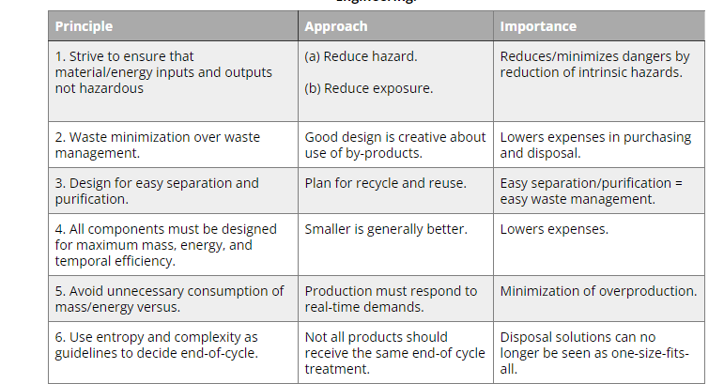
Principle of sustainable Engineering

Slide 24
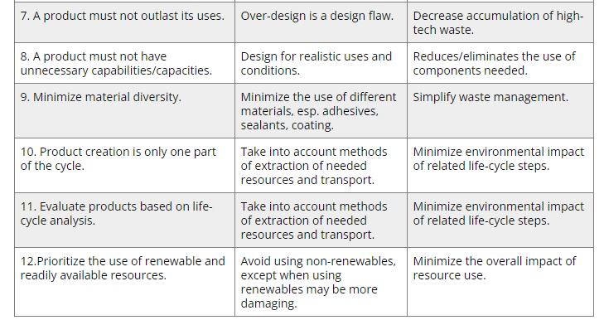
Principle of sustainable engineering

Slide 25
Fundamental of system analysis
To build the contextual framework for applying the sustainability principles, we need to develop some background in systems. We often hear terms like “systems thinking” or “systems approach”. Or in some cases, to initiate a sustainable and long-lasting change, we need to change the “system” rather than trying to change the final result. The material in this section is the tip of a bigger iceberg – system analysis is applicable to a very broad scope of problems, from economics to climatology, and it very often becomes a powerful tool in strategic decision-making. In this course, the systems approach will be essential when we consider technology trends and implementation in a broader societal context, where multiple forces – economic, environmental, political, educational, and psychological - come into play. It is not about simple ‘yes/no’ questions – it is our way to explore the complexity and possibly to find answers to ‘why’ questions for the most part. Let us start with some definitions.
Are we dealing with a system?
A system is an interconnected set of elements that is organized in a way that achieves a purpose.

Slide 26
Fundamental of system analysis
Three distinct entities of any system are elements, interconnections, and purpose (or function). These ensure system’s integrity and often determine such system’s properties and behaviors as development, resiliency, self-organization, self-repair, and eventually - sustainability. You can tell that you are dealing with a system, not a random collection of components, if you can identify the mutual impacts between the components and observe the outcome or behavior over time that is different from the outcomes or behavior of the separate components on their own.
For example, a forest is a system consisting of trees, soil, multiple species of flora and fauna – all of which are interconnected via food chains, nutrient flows, energy exchange, and many other chemical and physical processes. Its function is to provide environment and nutrition for sustaining living organisms and also to produce oxygen via photosynthesis. If one takes an element out of the system (e.g., taking a certain tree species and planting it in an isolated environment, or taking an animal and placing it in a zoo), those elements would behave differently, the same as the system deprived of a certain element will be affected and will react to the change.

Slide 27
Fundamental of system analysis
In a social context, for example, a village is also a system, not a simple aggregation of houses and people. Houses may be connected through the utility networks, people are connected through trade, collaboration, and social relationships. Disruption of life and function on one side of the village would cause system’s reaction and change.

Slide 28
Growth decay and tipping point
Growth
Since this lesson has some analysis and discussions of growth, it would be interesting to see how growth happens in system dynamics. Two types of growth we want to pay attention to are linear and exponential. Linear growth is when a value grows at a constant rate (slope). Positive couplings in systems are a usual cause of linear growth. For example, more product sold means higher profit; more fuel burned, more energy is released – those are simple observations. Exponential growth is different – it goes at an increasing rate – it accelerates! Systems with positive feedback loops often exhibit exponential growth, because the initial stock is continuously compounded by the positive couplings included in the loop.
Mathematically, these two types are schematically represented in Figure 1.22.

Slide 29
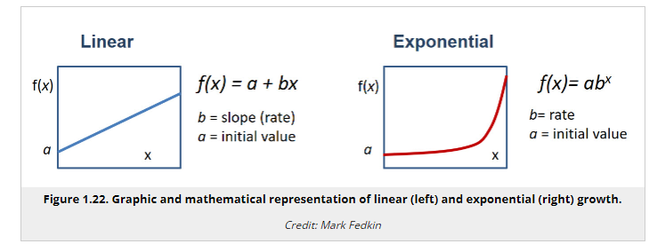
Growth decay and tipping point

Slide 30
Growth decay and tipping point
One of the examples shown in the previous section was about the bank account with interest. Adding interest to your balance increases the initial stock and thus earns you higher interest. This illustrates how a positive feedback works. Another example is population growth. When unhindered, the positive feedback loops are expected to cause exponential changes in system stocks.

Slide 31
Growth decay and tipping point
Example: How to Use Exponential Formula
f(x) = ab^{x}
This mathematical expression generically represents an exponential process. In this formula:
f(x) is a function – the amount we try to track over time. In the case of a bank account, it will be the account balance, or in case of population growth - the number of chickens, bacteria, or people.
a is the initial value, e.g., the account balance to start from or starting population of species.
b is the base, which indicates the factor by which the initial amount changes per unit of time. For example, if the number of bacteria doubles every hour, b=2. Or if the bank account grows by 6% every year, b=1.06.
x is an exponent, which acts essentially as a time coordinate. For example, if you try to calculate the function for 10 hours ahead, x=10.
Starting with 1 bacteria (a=1) and hourly doubling increase (b=2), in 10 hours we will have f(x) = 1 x 2¹⁰ = 1024 bacteria.

Slide 32
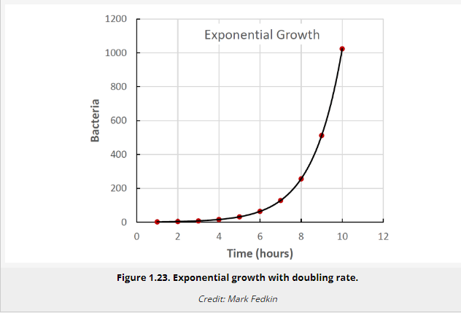
Growth decay and tipping point

Slide 33
Growth decay and tipping point
From the above examples, we can make a few interesting observations:
Exponential growth starts slow, but it becomes fast very fast.
The result of exponential growth is very hard to predict intuitively because we are used to thinking linearly
Very often, exponential growth is the result of positive feedback in the system
Negative (balancing) feedbacks are one way to limit system growth
Exponential growth cannot be sustainable within a finite-size system and reaching capacity crisis is only a matter of time.
Delays
When we discussed couplings in systems, we mentioned that such causal connections exist when A affects B in either a positive or negative way, but we did not pay much attention to how fast that happens. Some changes can be almost instantaneous (or at least seem like that). For example, clouds moving across the sky immediately change the flow of solar energy coming down to earth, and suddenly we feel cooler, or if the sunlight is used for electric generation, the voltage of the solar panel quickly drops. But other changes may take minutes, hours, days, years, and even millennia. That essentially means we have a delay between the cause and its effect.

Slide 34
Growth decay and tipping point
Examples of systemic delays are multiple. Here are just a few:
Incubational period of a viral disease – time between virus entering the body and symptoms
Forest growth – time between seeds germinate in the soil and trees reaching a certain height;
Greenhouse effect in climate – time between atmospheric carbon dioxide concentration increase and global temperature increase
Prices in the market – time between supply or demand grow and decision to adjust the price for a product.
The larger the system, the greater the volume of the stock, the longer it takes for it to respond to change. That is why planetary system often experiences changes (climate, ocean chemistry, geochemical cycles) with significant delays - at the scale of thousands and millions of years. That is why technological, economical, and cultural changes often happen much faster at the community level than at the national level.

Slide 35
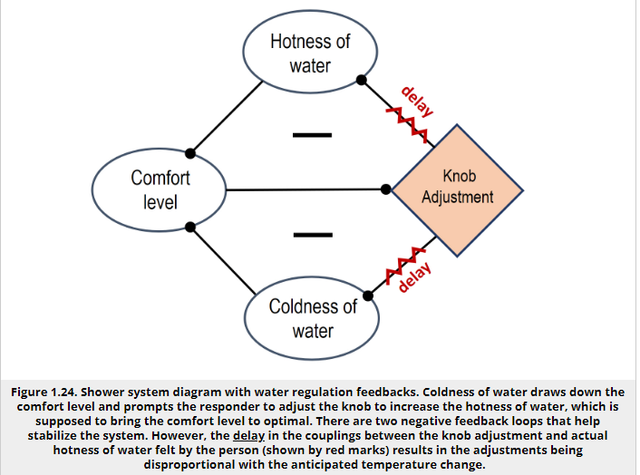
Growth decay and tipping point

Slide 36
Growth decay and tipping point
In this process, the temperature of water goes up and down, only bypassing the optimal comfort temperature, resulting in oscillation. Eventually, understanding the delay, you start being more patient, wait for the change and make smaller adjustments. With a few more overshoots, you finally reach the optimal temperature. The system is stabilized!
Why are you able to stabilize the system eventually? In the process of regulating water temperature, you learn – you get information about how long the delay is between the knob turn and actual water temperature change. You also learn how much the temperature changes per certain degree of knob turning. Of course, you process this information almost subconsciously, and it takes a little bit of trial and error.

Slide 37
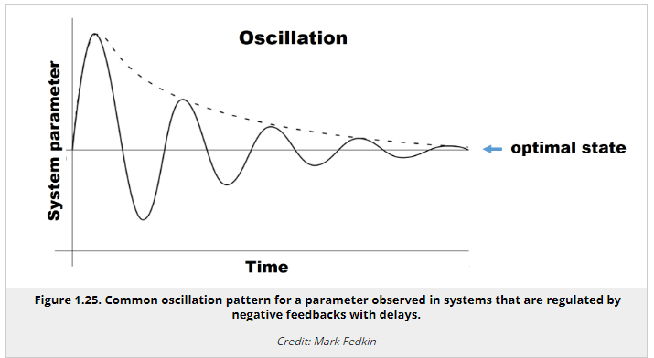
Growth decay and tipping point

Slide 38
Tipping points
Tipping points is another interesting phenomenon that occurs in some systems. This topic can certainly be a subject for a deeper discussion, but it is worth mentioning it here at least briefly.
Tipping point is a special condition in a system, at which a very small perturbation or causes a large or even catastrophic change. Obviously, the small change is not the main cause, but only a trigger, the last drop in a long and sometimes complicated chain of interactions and events that lead the system to this condition. The term “tipping point” originated in the mathematical catastrophe theory(link is external) and only recently started to be used in the global environmental context. Most frequently, tipping points are investigated in the relation to climate science and ecology.
Tipping points are frightening because they are not easily predictable, and when the tipping events are triggered, there is no way to reverse the process. Also the events that occur when a system passes through a tipping point are usually dramatic, proceed at a high rate, and have no forewarning.

Slide 39
Tipping points
Therefore, understanding the nature and the actual causes behind the tipping points is important for designing preventive measures. Tipping points are very characteristic of systems with counteracting negative and positive feedbacks.
If you are compelled to read more about this concept, additional explanations and some good examples are given in the following reading:

Slide 40
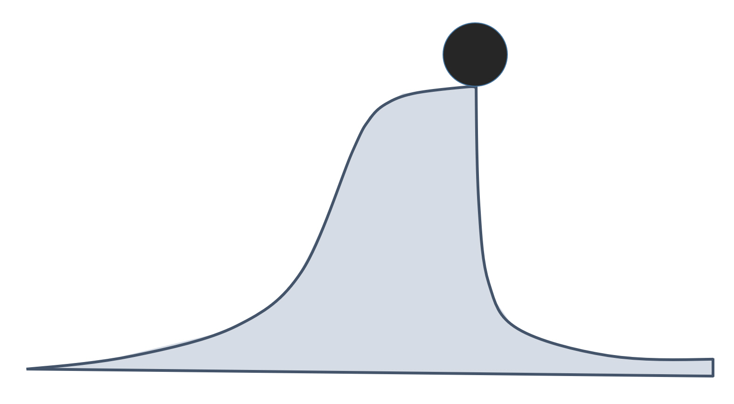
Tipping points

Slide 41
Tipping points
It should be understood that tipping points are not results of external forces, which can also cause dramatic shifts and catastrophes, but are rather internally justified. Another take-away is that, like any other systemic phenomena, tipping points can happen in both natural and social worlds – they are not only confined to the physical processes. Tipping points are observed in societal systems and can be marked by major paradigm shifts, dramatic changes in thinking, decision making, and political transformations. It is very possible that passing of the human society from the current state to a new state with a higher degree of sustainability may also require passing through a tipping point when some traditional worldviews are rejected, and new ones are adopted. Hence, the tipping points do not only present risks, but also opportunities in socio-economic evolution.

Slide 42
Technology as a part of anthropogenic environment
The common definition of the term technology is quite broad and multi-colored. The most simplistic one is application of scientific knowledge for practical purpose. And as an extension of it, the tool or device enabling that application is typically also referred to as technology. You can read more on the history and usage of this term in a Wikipedia article on Technology(link is external). You may recognize that the meaning strongly depends on the context and the professional area you are in. However, in this course, we need to distill this broad perception of technology to a more specific entity that can be used for practical analysis.
Energy and matter conversion
The most important ability of almost any technology is conversion. A technology uses inputs of energy or matter to create outputs of energy or matter of a different quality. In a general case, any technology can be represented by the following scheme (Figure 2.1):

Slide 43
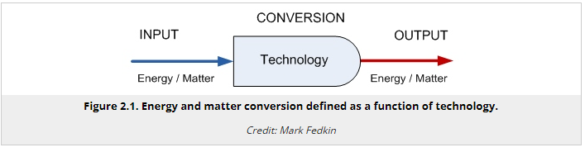
Technology as a part of anthropogenic environment

Slide 44
Technology as a part of anthropogenic environment
So, technology typically serves as a conversion portal in a system. We use energy to produce materials; or use raw materials to produce some more complex products; or we use matter to convert forms energy; etc. Note that conversion can also be performed by natural systems or mechanisms; but we only define technology as a human-made conversion system. Here are some simple examples:
Chemical energy of fuel >>> Car >>> Kinetic energy of car motion
Radiative energy (sunlight) >>> Solar panel >>> Electric energy
Electric energy >>> Phone >>> Sound, light
Contaminated water >>> Water treatment plant >>> Clean water
Electric energy >>> Furnace >>> Thermal energy
Flour, water >>> Baking machine >>> Bread
Organic waste >>> Composting >>> Fertilizer
Electricity, mechanical energy >>> Electric guitar >>> sound

Slide 45
Technology as a part of anthropogenic environment
Conversion efficiency
Obviously some technologies are better converters than others, and the following metric allows us to compare different technological options and choose a "better deal" in terms of useful output and money spent.
The key characteristic of any conversion process is efficiency. Efficiency is estimated based on the amount of useful output per unit input. In that sense, it is a subjective value which depends on a particular goal or purpose of a technological process, and a particular input resource we are concerned about. Hence, efficiency has widely varying meanings in different disciplines.
For example, efficiency is a very common metric in the field of energy conversion. According to the energy conservation law, the total energy entering a conversion device should be equal to the total energy output by the device:
E_{in} = E_{out}
Some of the output energy can be considered useful (based on the purpose of conversion), and some of it can be considered not useful and attributed to "losses":
E_{out} = E_{out}(useful) + E_{out}(loss)
What is useful and what is not is up to us to define (nature does not care!).
So, efficiency determines the fraction of the useful energy as follows:

Slide 46
Technology as a part of anthropogenic environment
Efficiency = E_{out}(useful) / E_{in} × 100%
Efficiency is important in the sustainability context because it indicates how much of the resource is put to work, and how much of the resource is wasted in the process. The reasons for losses are process dependent and should be analyzed specifically for each application. A big part of the technological research is aimed at increasing efficiency of the conversion process via minimizing losses.

Slide 47
Technology readiness levels(TRL)
Technology Readiness Levels (TRL) are a type of measurement system used to assess the maturity level of a particular technology. Each technology project is evaluated against the parameters for each technology level and is then assigned a TRL rating based on the projects progress. There are nine technology readiness levels. TRL 1 is the lowest and TRL 9 is the highest.

Slide 48
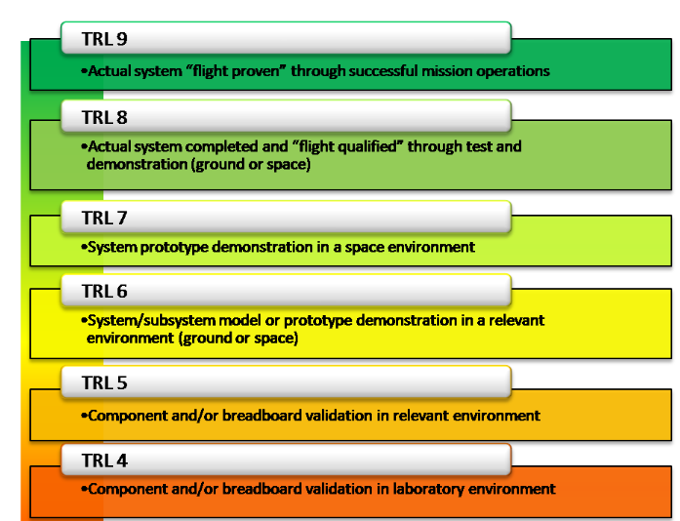
Technology readiness levels(TRL)

Slide 49
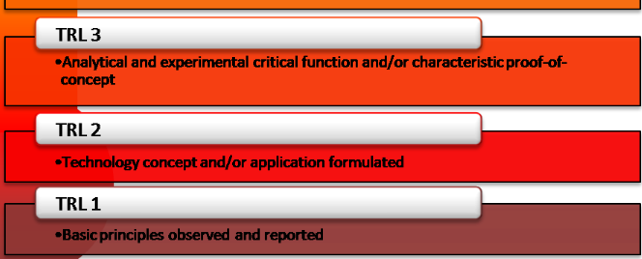
Technology readiness levels(TRL)

Slide 50
Technology readiness levels(TRL
When a technology is at TRL 1, scientific research is beginning and those results are being translated into future research and development.
TRL 2 occurs once the basic principles have been studied and practical applications can be applied to those initial findings. TRL 2 technology is very speculative, as there is little to no experimental proof of concept for the technology.
When active research and design begin, a technology is elevated to TRL 3. Generally both analytical and laboratory studies are required at this level to see if a technology is viable and ready to proceed further through the development process. Often during TRL 3, a proof-of-concept model is constructed.
Once the proof-of-concept technology is ready, the technology advances to TRL 4. During TRL 4, multiple component pieces are tested with one another.
TRL 5 is a continuation of TRL 4, however, a technology that is at 5 is identified as a breadboard technology and must undergo more rigorous testing than technology that is only at TRL 4. Simulations should be run in environments that are as close to realistic as possible.

Slide 51
Technology readiness levels(TRL
Once the testing of TRL 5 is complete, a technology may advance to TRL 6. A TRL 6 technology has a fully functional prototype or representational model.
TRL 7 technology requires that the working model or prototype be demonstrated in a space environment.
TRL 8 technology has been tested and “flight qualified” and it’s ready for implementation into an already existing technology or technology system.
Once a technology has been “flight proven” during a successful mission, it can be called TRL 9.

Slide 52
EMERGING
Technologies play a critical role in ameliorating many of the sustainability challenges facing humanity and can be designed to limit human impacts on the environment. This Collection highlights some exciting developments of frontier technologies with sustainability potential.
Sustainable development is a global goal that aims to balance the needs of people, planet, and prosperity. It requires the wise use and management of natural resources, such as water, land, energy, and biodiversity. But how can we achieve sustainable development in the face of climate change, population growth, and social inequalities? In this article, we will explore some of the emerging trends and technologies that can support sustainable development policies and practices.

Slide 53
CONVERGING
Is technology our last desperate hope to avoid radical climate change, resource depletion and environmental degradation?
Current developments in nanotechnology, life sciences, and other so-called convergent technologies (AI, VR, AR, 3D printing, IoT, Robotics, Blockchain) are fueling hope that long-term technological, environmental, and economic sustainability can be achieved through responsible research and innovation in these areas.
The first major program on converging technologies promoted the convergence of nanotechnology, biotechnology, information technology, and cognitive science (NBIC) to improve human performance (Roco et al., 2002). The concept of convergence thus provides a framework for developing a strategy that aligns many partners around a social problem to be solved.
The most common sustainability definition is: "Sustainable development is development that meets the needs of the present without compromising the ability of future generations to meet their own needs”. With this definition, the 1987

Slide 54
CONVERGING
Brundtland Report leaves open various possibilities as to how sustainable development could be achieved. In a sense, this definition of sustainable development could be a license to do whatever it takes to meet our own needs while investing in technologies that will enable future generations to meet their own needs as we do. If we are to keep our economic promise to future generations without compromising consumption and economic growth, technology (with its ever-accelerating convergences) could be the wild card that keeps us from conserving or living within certain limits.
In the vision of a finite world in which resources must be conserved, restored, recycled or replenished, it is often said that there can be nothing really new, but (as in the conservation of matter) only redistributions and distributions of what already exists. We have inherited the planet Earth and all of nature and we must pass them “as is” on to the next generation. The convergence of technical-scientific promises, on the other hand, is the regime of innovation, of the search for renewable energies and of the systematic exploration of new properties.
These scientific promises might encourage us, skeptical of technology as a solution to all our problems, to pin our hopes on this wild card in a somewhat desperate attempt to achieve sustainability.
Or should we remain skeptical? The future will tell.

Slide 55
DISRUPTIVE TECHNOLOGY
Disruptive technology is a term that applies to gadgets, electronics, services and concepts that have a major impact on their respective industries, ultimately changing them in irreversible ways.
Working with disruptive technology, businesses can often establish themselves in new markets or take advantage of the opportunity to displace big companies in an established landscape. Understanding how this type of technology influences industries is important. In this article, we explore what disruptive technology is, its benefits and major examples of disruptive technology.

Slide 56
CONVERGING
Disruptive technology is any innovation that dramatically changes the way consumers, businesses and industries operate. When they're first developed, disruptive technologies often create a new market. They establish their own value network and are often seen as risky outliers when they're introduced.
In other cases, disruptive technologies enter an established market but radically change the way business is handled and needs are met. These technologies completely replace their predecessors by offering revolutionary benefits that are notably superior. When a disruptive technology enters an existing market, it can make current items or processes obsolete.

Slide 57
Examples of disruptive technology
Here are a few examples of disruptive technologies:
Artificial intelligence
Artificial intelligence is a technology that allows computers to problem solve and reason in the same ways that humans do. Examples of Artificial Intelligence include:
Robots
Self-driving cars
Home assistants
Chatbots found on retail sites
Digital travel agents
3D Printing
3D printing is used in several industries—primarily the medical and aeronautical fields— and is the process of creating three-dimensional objects from a non-three dimension source, such as a digital source. Objects are created layer by layer in this process and this allows people to print unusual shapes with fewer materials.
Blockchain

Slide 58
Examples of disruptive technology
Bitcoin and cryptocurrency are examples of currency that are exchanged in digital ledger transactions through what is called a blockchain service. While this process is still evolving and hasn’t quite reached the masses yet, it’s considered a disruptive technology that is changing the e-commerce industry. It’s important because it involves a cashless system that will change how we exchange money.
Smartphones
Smartphones have replaced landlines, traditional cell phones and even computers for many people. As new apps become available, smartphones increase their functionality, disrupting other industries as well. A smartphone can act as a GPS, radio, television, e-reader (which itself replaced printed materials), camera, remote control and more.

Slide 59
Examples of disruptive technology
E-commerce
E-commerce makes nearly any product accessible via the internet. Shoppers no longer have to leave their homes and shop at brick and mortar stores and startup companies don't need physical retail locations to sell their products. E-commerce disrupted the retail industry by making it possible to shop online and receive anything from shoes to produce in a matter of days or even hours.
Ride-sharing apps
With the advent of ride-sharing apps, customers can now order transportation from individuals rather than a taxi cab company. Customers use an app to arrange where and when they’d like to be picked up. Ride-sharing changed the industry, both for the consumer and the driver, who can now work independently for ride-sharing companies, setting their own hours and choosing jobs.
GPS systems
Global Positioning Systems (GPS) have replaced paper maps. Drivers once had to consult paper maps to find their location if they were lost. Modern GPS technology can find users instantaneously by satellite and provide route choices for their destinations. With convenient, turn-by-turn directions, and rerouting options for traffic and road obstacles, the driver is able to focus on driving.
ms are even available to stream while still in the theater, so customers can stay home and stream them.

Slide 60
LIFE CYCLE ASSESSMENT
Life cycle sustainability assessment (LCSA) refers to the evaluation of all environmental, social and economic negative impacts and benefits in decision-making processes towards more sustainable products throughout their life cycle.

Slide 61
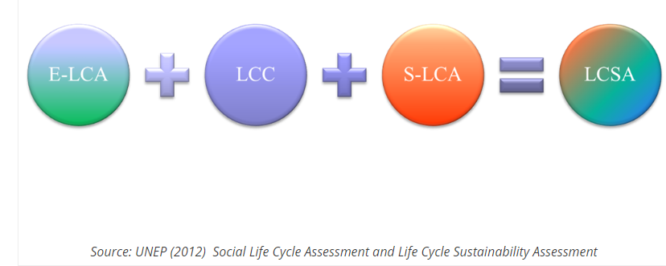
LIFE CYCLE ASSESSMENT

Slide 62
LIFE CYCLE ASSESSMENT
Increasing interest in developing methods to better understand and address the impacts of products along their life cycle has been stimulated by a growing global awareness of the importance of protecting the environment; an acknowledgement of the risks of trade-offs between possible impacts associated with products (both manufactured and consumed); and the necessity of taking account of climate change issues and biodiversity from a holistic perspective. Potential and future decision-makers, stakeholders, enterprises and consumers can benefit from LCSA in the following ways:
LCSA enables practitioners to organize complex environmental, economic and social information and data in a structured form.
LCSA helps in clarifying the trade-offs between the three sustainability pillars, life cycle stages and impacts, products and generations by providing a more comprehensive picture of the positive and negative impacts along the product life cycle.

Slide 63
LIFE CYCLE ASSESSMENT
LCSA will show enterprises how to become more responsible for their business by taking into account the full spectrum of impacts associated with their products and services.
LCSA promotes awareness in value chain actors on sustainability issues.
LCSA supports enterprises and value chain actors in identifying weaknesses and enabling further improvements of a product life cycle. For instance, it supports decision-makers in enterprises in finding more sustainable means of production and in designing more sustainable products.
LCSA supports decision-makers in prioritizing resources and investing them where there are more chances of positive impacts and less chance of negative ones.
LCSA helps decision-makers choose sustainable technologies and products.
LCSA can support consumers in determining which products are not only cost-efficient, eco-efficient or socially responsible, but also more sustainable.

Slide 64
LIFE CYCLE ASSESSMENT
LCSA stimulates innovation in enterprises and value chain actors.
LCSA has the potential to inform labelling initiatives.
Communicating transparent LCSA information helps enterprises to raise their credibility.
LCSA provides guiding principles to achieve SCP.

Slide 65
MCQ s
1. Any contaminated components that seep into the soil, filtration, and are transferred into the underground reservoir are referred to as
Water Pollution
Noise Pollution
Land Contamination
Air pollution.
Answer: C
2. Which resource is South Africa’s most important export?
Copper
Diamond
Silver, and
Gold
Answer: D
3. Which option is true if just two of the three foundations of Sustainable Development are encountered?
Viable = Economic + Ecological Sustainability
Bearable = Social + Ecological Sustainability
Equitable Social + Economical Sustainability
None of the preceding
Answer: D

Slide 66
MCQ s
5. What year did the concept of sustainability first appear?
1992;
1978;
1980;
1987;
Answer: C
6. In the year, the U.N. General Assembly constituted a Committee on Sustainability (CSD).
1995;
1994;
1993;
1992;
Answer: D
7. The vast holes left behind after mining are utilised for
wastewater storage,
domestic wastewater storage,
waste disposal, and
waste storage.
Answer: C

Slide 67
MCQ s
8. Which of the following options is not included in the sustainable development parameters?
Gender inequality and diversity
Intergenerational and intragenerational equity
Growing annually
None of the above
Answer: D
9. What is the definition of sustainable development?
The growth that satisfies current demands without jeopardising future generations’ ability to fulfil their own needs.
Conserve mineral wealth and explore alternative energy sources while decreasing pollution and environmental impact.
It is the process of creating land and building projects in such a way that they have a lower environmental effect by enabling them to produce fuel-efficient self-sufficiency patterns.
All the preceding
Answer: D
10. If we only accomplish two of the three foundations of Sustainable Development, which of the preceding is correct?
Social + Financial Longevity = Fairness
Bearable = Economic + Ecological Sustainability
Viable = Socio + Ecological Sustainability
All of the preceding.

Slide 68
Thank You

